Slide 1
Test Levels

Slide 2
Recall: Software System Decomposition
Software System Decomposition
System
System testing, Acceptance testing
Integration testing
Component 1
Comp. n, etc.
Regression testing
Unit 1
Unit 2, etc.
Unit 3
Unit 4, etc.
Pyunit
Unit Testing
Function 1
Funct 2, etc.
Function 3
Funct 4, etc.

Slide 3
Test Driven Development (TDD)
A philosophy whereby we start by asking the question “How can I test this?” or “Can this be tested?” or “How will I test this?”
Not uniquely tied to any particular testing phase – but it a way of thinking about any type of testing / development.
Why bother with TDD?
It places an emphasis on thinking about the operation of the software once completed.
If it cannot be tested, it should not be implemented?
Or: no point implementing something if we cannot test it?
Effective thinking for the early identification of possible defects.
Forces us to clarify and improvement the completeness of our thinking earlier – which is typically a desirable economic proposition.

Slide 4
Component testing
A component can be a single unit or a collection of units
The first dynamic test stage is sometimes considered to be component testing – though in a contemporary sense, this is probably framework driven unit testing.
Performed on components in isolation.
Stubs, drivers and simulators may be used.
May include testing of some non-functional characteristics.
Typically, a technical activity, performed by programmers.

Slide 5
Integration testing
Many components may be integrated into a large system.
When components are integrated into a system, we may need to perform dedicated integration testing.
Integration testing is based on the build and integration sequence
An incremental approach may be used – testing for high level features first.
A technical activity, performed by the developers, like component testing. Sometimes performed by testers?

Slide 6
Software integration and Component Integration testing
Integration and integration testing is not well understood
In the coding stage, you are performing "integration in the very small"
Strategies for coding and integration:
bottom up, top down, "big bang"
appropriate in different situations

Slide 7
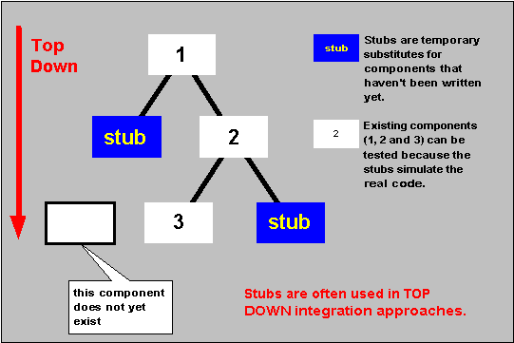
Stubs and top down testing

Slide 8
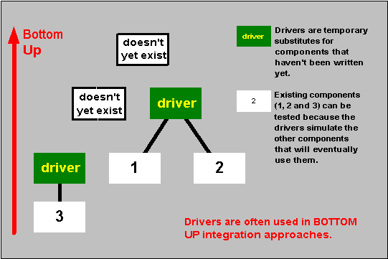
Drivers and bottom up testing

Slide 9
What does a stub or driver look like?
Stubs and drivers can take many forms.
They can be implemented in a script that interacts with the software under test.
They can be implemented as a separate program, perhaps written in the same programming language (perhaps not).
May use a 3rd party product to build a stub or driver.
Stubs/Drivers: May include logging and recording for tests, and automated checking of logs for errors.

Slide 10
Note of caution on terminology
The distinction that we have drawn between Stubs and Drivers may not be generally held in practice.

Slide 11
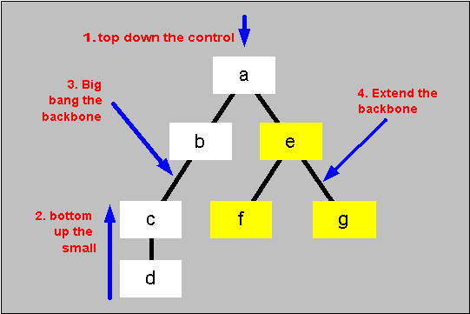
Mixed integration strategy

Slide 12
Component Integration testing
Tests designed to explore direct and indirect interfaces and consistency between components.
First stage where products of several programmers are combined
Can reveal consequences of inconsistent assumptions or bad communication
Usually performed by an individual within a development group – but can be the responsibility of a small dedicated team.

Slide 13
Definition of interfaces
Statements which transfer control between programs
Parameters passed from program to program.
Variables defined at the time of transfer

Slide 14
Interface testing / defects
White-box oriented
Integration faults reveal project communication failures
Transfer of control to the wrong routine
Wrong type (hierarchical or lateral) of transfer of control
Incorrect type, number or order of parameters.
Programs validate common data inconsistently
Read-only parameters or global data that is written to.

Slide 15
Global data
Global data may reduce the memory required by a system
May simplify call mechanisms between routines
Lazy programmers over-use global data
Is error-prone, and can be difficult to debug.

Slide 16
Assumptions about parameters and global data
Assumed initialised e.g.:
assumed set by caller
variable assumed incremented before rather than after a call (or vice versa)
Other assumptions:
"ownership" of global data
variables are always correct.
Assumptions / expectations need to be teased out through testing and not overlooked.

Slide 17
Inter-module parameter checking
Does the called routine explicitly check input parameters?
Does the calling routine check
called routine return status?
returned values?
Programming or interface standards should define whether callers, called or both routines perform checking and under what circumstances.

Slide 18
System and Acceptance Testing
System and acceptance testing focus on the testing of complete systems
System testing has multiple "drivers".

Slide 19
System testing
A systematic demonstration that all features are available and work as specified
Coverage of all documented features (not code), conditions, system states is the imperative
Tests designed around baseline document(s) [i.e. not based on the implementation details]
Functional and non-functional requirements are covered.
Often, non-functional requirements can be poorly defined and are last to be performed – but can be difficult to resolve issues in this area (e.g. functionality is delivered but performance is poor).
Non-functional requirements are therefore just as important as functional requirements but may be last to be evaluated (and indeed, sometimes unclear until the operational environment is made available).

Slide 20
Functional and non-functional system testing
System functional and non-functional testing
Functional system testing
concerned with functional requirements
fault-detection a major objective
"what the system must do"
Non-functional system testing
concerned with non-functional or technical requirements
"how the system does what it does".

Slide 21
Acceptance testing (UAT)
Done from an end user's viewpoint
Fit with business process is the imperative: does it help the users do their job?
May place an emphasis on essential features: some delivered features may not be completely tested.
Testing based around how users use the system.
Usual to assume that all major faults have been removed and the system works (be careful with assumptions…!).
Acceptance tests:
usually a smaller-scale test than system test
can be a selected sub-set of system tests (perhaps in a different environment)
Acceptance may not require its own test
Sometimes based on satisfactory conduct of system tests, often witnessed.
Depends on the contractual position
Q. Do google run acceptance tests?

Slide 22
Requirements-based testing
Acceptance tests and some system tests are usually requirements-based
We can scan requirements documents:
which features should be provided
what conditions should be covered
Requirements based tests:
can help to demonstrate that the supplier has met every requirement
less influenced by the solution provided by the supplier.

Slide 23
Problems with requirements
Requirements don't usually give us enough information to test
intents, not detailed implementation
need to identify features to test
many details might be assumed to exist, but can't be identified from requirements
e.g. field validation, navigation paths, data integrity rules all added by developers.

Slide 24
Alpha and beta testing
Often used by suppliers of packages (particularly shrink-wrapped)
Where supplier wishes to receive feedback from actual or potential customers
Alpha testing normally takes place on the supplier site
Beta testing usually conducted by users on their site.

Slide 25
Alpha & Beta test
Alpha test
software
customer tests
developer site
customer site
Beta test
developer
reviews
customer
tests
software
developer site
customer site

Slide 26
Alpha and beta testing - intent
Assess reaction of marketplace to the product
Are major features missing?
Do new features 'miss the point'?
Is product ready for release?
Some suppliers leave faults in the software to get bug reports returned to gauge?
where software is being used most
where users are most sensitive to faults.

